Slide 1
Electric Motor Temperature
Group 6 :
Presented by
SIDDHESH PATIL
SAMRAT PAWAR
ANSARI INAMULLAH AKHTAR

Slide 2
Business Problem
The main purpose of the data set's recording is to be able to model the stator and rotor temperatures of a PMSM in real-time.
Due to the intricate structure of an electric traction drive, direct measurement with thermal sensors is not possible for rotor temperatures, and even in case of the stator temperatures, sensor outage or even just deterioration can't be administered properly without redundant modeling.
In addition, precise thermal modeling gets more and more important with the rising relevance of functional safety.
Objective :
Predict Motor temperature (“PM”) based on other attributes available are like ambient, coolant, torque, current d_q components, voltage d_q components, stator yoke, stator tooth, stator winding, permanent magnet and profile_id.

Slide 3
Project Architecture / Project Workflow
Data cleansing
Duplicate values removal
Missing values treatment
EDA
Outlier treatment
Feature Engineering
Data pre processing
Data type conversion
Normalising/ standardising the data
Data visualisation
Model building
Regression model
Tree model
Model evaluation
Evaluating using RMSE metric
Model deployment
Deploying using Shiny

Slide 4
Data Cleansing
There are 998070 rows and 13 columns in the training dataset
there are no NA and duplicate values in the given data set.
Check all the business moments.
Majority of the variables are right skewed and has long tail in the end.
While others are left skewed and has long tail in the beginning.
We will remove the 1st variable because it’s a serial number.
When we check the structure of the data set except profile_id others are numeric. Now we have to convert profile_id into factor.
Exploratory Data Analysis : (EDA)
After converting into factor we will get 52 levels.
Now find the correlation ship between the variables. There is a collinearity also.
Now we have to make the profile_id into unique, by doing this we will come to know how many levels are there.
The data set will follow normality.
When we used scatterplot we came to know about linearity. Data set follows positive linearity.
Histogram and bar plot will help us to find the variation in the data set.

Slide 5
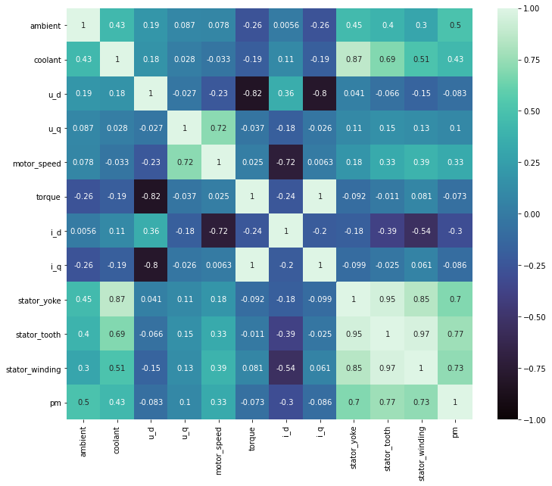

Heat plot will tell us whether there are any NA values and correlation of the variables.

Slide 6
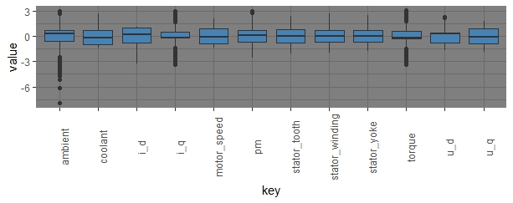
Outliers: Ambient i_q Torque Outliers are removed Using caping technique of outlier treatment.

Slide 7
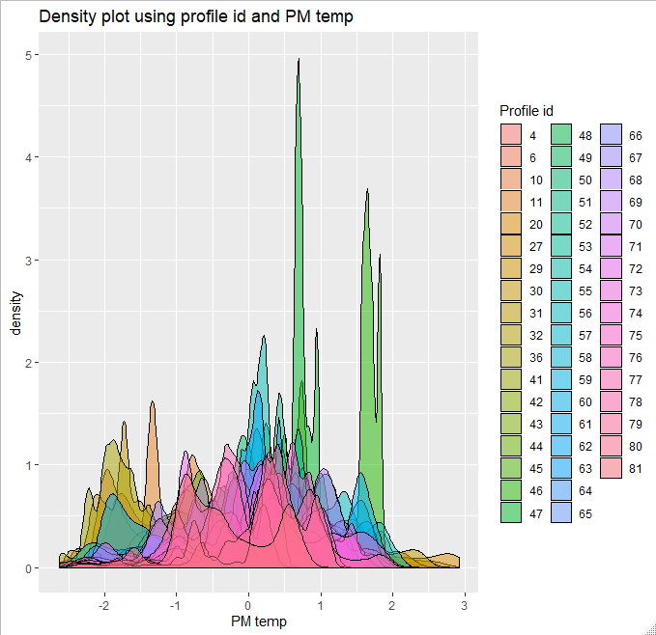

Slide 8
Model Building :
Data Set Details :
998070 rows and 13 columns
Data - Continuous
Data Partition :
Data is divided into 70:30 train and test.
Based on this data we are going to perform Model Building.
Train = 698649 rows X 11 Columns
Test = 299421 rows X 11 Columns
Linear Regression
XGBoost Regressor
K-Nearest Neighbour Regressor
Adaboost Regressor
ALGORITHMS :

Slide 9
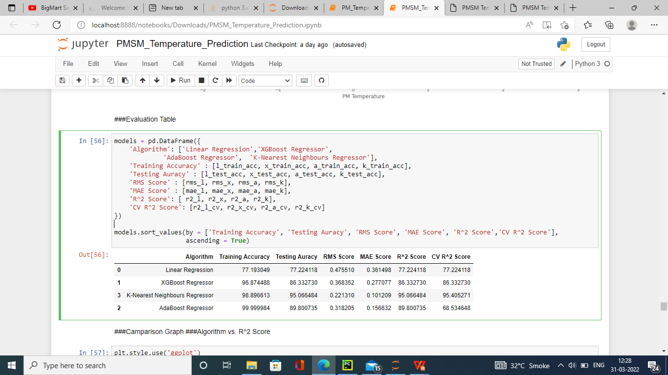
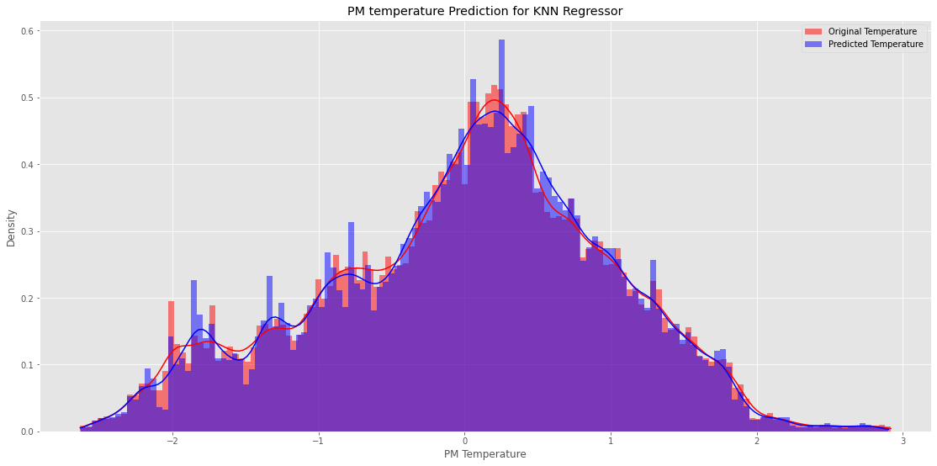
Model Evaluation :
KNN Regressor:
Original Temp Predicted Temp
0 0.463110 0.398646
1 -0.980749 -0.986900
2 0.510929 0.494875
3 -1.260174 -1.262803
4 1.267661 1.252173

Slide 10
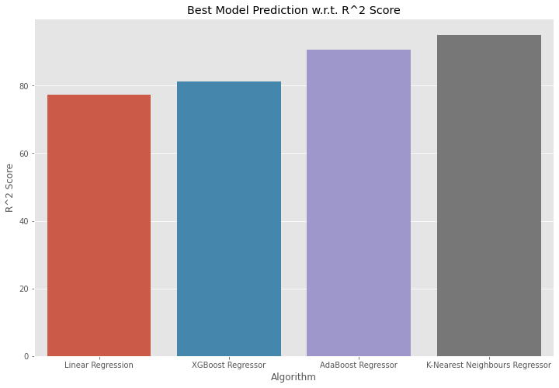
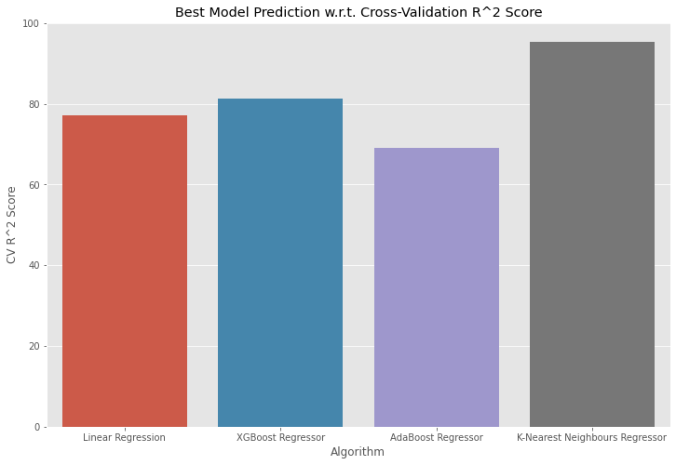

Slide 11
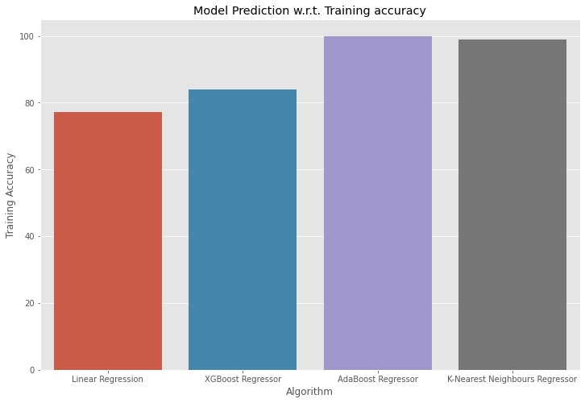


Slide 12
Model Deployment using Flask
Step 1 :
Created a “joblib” file for model .
Joblib clearly outperforms pickle and numpy in terms of memory consumption. This can be explained by the fact that numpy relies on pickle if the object is not a pure numpy array (a list or a dict with arrays for example), so in this case it inherits the memory drawbacks from pickle.
Created a joblib file using “.sav” extension using path.
import joblib
joblib.dump(grid_search_forest,r"C:\Flask\models\KNNRegressor.sav")
model=joblib.load(r"C:\Flask\models\KNNRegressor.sav")

Slide 13
Step 2 :
Create an HTML page/file with or without CSS which would be index page
One page could be created both to recieve the user input and display the result or separate page could be created to receive the input and then to display the result.
This file should have an extension as “.html” and these files should be stored in the folder.

Slide 14
Step 3:
Create an file with an extension “.py” using python editor like jupyter Notebook.
#import the library files:
from flask import Flask, jsonify, render_template, request
import joblib
import sklearn
import os
import numpy as np
import pandas as pd
#Initialize the flask name
app = Flask(__name__)
#Define html file to get user input
@app.route("/")
def index():
return render_template("home.html")

Slide 15
#Prediction Output Page and Logic:
@app.route('/predict',methods=['POST','GET'])
def result():
ambient= float(request.form['ambient'])
coolant=float(request.form['coolant'])
u_d= float(request.form['u_d'])
u_q= float(request.form['u_q'])
motor_speed = float(request.form['motor_speed'])
torque= float(request.form['torque'])
i_d= float(request.form['i_d'])
model_path = r"C:\Flask\models\KNNRegressor.sav"
model = joblib.load(model_path)
result = (np.array([ambient, coolant, u_d, u_q, motor_speed, torque, i_d]).reshape(1, -1))
prediction = model.predict(result)
return render_template('index.html', result=prediction)
#main function:
if __name__ == "__main__":
app.run(debug=True, port=9457)

Slide 16
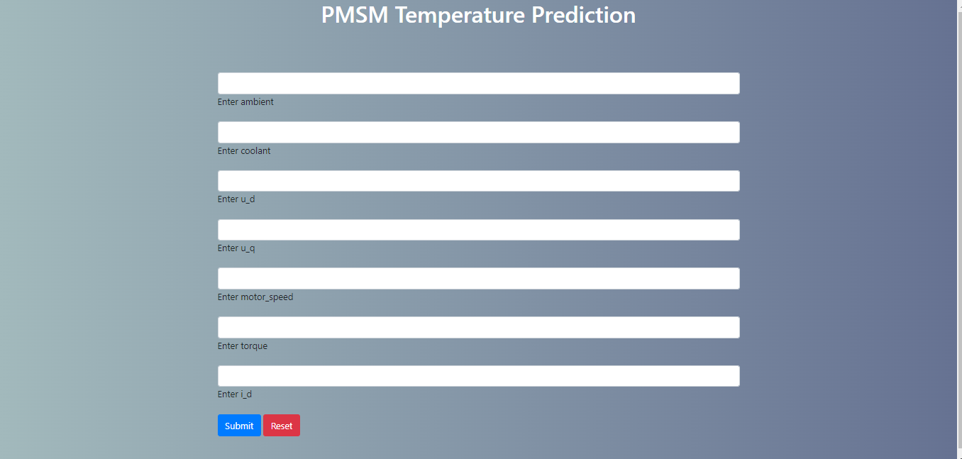

Slide 17
Challenges Faced:
Data visualisation took more time for plotting data.
The dataset contained with large amount of outliers.
Feature selection doesn’t improve the model evaluation metrics.
Model building was more complicated since, size of data set is very large.
model deployment was complicated
How did we Overcome :
Data visualisation was done for unique profile_id instead of whole dataset.
Outliers are treated using caping technique of outlier treatment.
From Feature selection profile_id also part of training dataset.
Model deployment was done using Flask.

Slide 18
Thank You

